Slide 1
Programming Fundamentals
By
Shazmeen Batool

Slide 2
Today’s Lecture
Computers
Components of Computer
Computer Programming

Slide 3
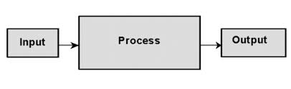
Computer
A Computer is an electronic machine which is used for data processing.
A computer is a programmable machine, i.e., A machine that can receive, store, and process data.

Slide 4
Functionality of Computer
Takes data as input
Stores the data/instructions in its memory and use them when required
Process the data and converts it into useful information.
Generates the output
Controls all the above four steps

Slide 5
Components of Computer
Hardware
Software

Slide 6
Components of Computer
Hardware
The physical equipment required to create, use, manipulate and store electronic data.
Computer hardware refers to the physical parts or components of a computer that we can touch.

Slide 7
Hardware
Input Devices
Central Processing Unit (CPU)
Arithmetic and Logic Unit (ALU)
Control Unit (CU)
Memory (Primary and Secondary)
Output Devices
Peripheral Devices

Slide 8
Hardware
Central processing unit (CPU):
The chip or chips at the heart of a computer that enable it to process data. Also known as a processor
The CPU’s job is to fetch instructions, follow the instructions, and produce some result.
Memory:
An area within a computer system that holds data waiting to be processed.
Storage device:
Secondary storage is a type of memory that can hold data for long periods of time, even when there is no power to the computer.

Slide 9
Hardware
Input devices:
The devices that allow data and instructions to enter a computer (such as a keyboard, mouse, scanner)
Output devices:
The devices that allow information to be represented (that is, given out) to the user, such as a display screen or printer)
Peripheral device:
Any piece of equipment in a computer system that is not actually inside the computer itself.
Printers, scanners and external disk drives

Slide 10

RAM
The most common type of memory that most users are familiar with is ‘main memory’ or ‘RAM’ (Random-Access Memory).
RAM holds an area in the computer system unit that temporarily holds a user’s data, operating system instructions and program instructions.
The word ‘main’ is used to distinguish it from external mass storage devices such as the hard drive or disk drives.

Slide 11
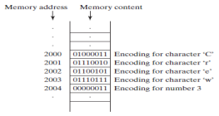
Memory
A computer’s memory consists of an ordered sequence of bytes for storing programs as well as data that the program is working with.
You can think of memory as the computer’s work area for executing a program. A program and its data must be moved into the computer’s memory before they can be executed by the CPU.
Every byte in the memory has a unique address, as shown in Figure.
The address is used to locate the byte for storing and retrieving the data. Since the bytes in the memory can be accessed in any order, the memory is also referred to as random-access memory (RAM).

Slide 12
ROM
Read Only Memory
Memory on which data has been prerecorded.
Once data has been written onto a ROM chip, it cannot be removed and can only be read.
Unlike main memory (RAM), ROM retains its contents even when the computer is turned off.
ROM is referred to as being nonvolatile, whereas RAM is volatile.
Most PCs contain a small amount of ROM that stores critical programs such as the program that boots the computer.

Slide 13
Software
Set of instructions written in some programing language.
A program is a sequence of instructions written to solve a particular problem.
Set of instructions that tells a computer component (hardware) how to perform a task.
Set of instruction =Program
Program is a set of instructions in any computer programming language which directs computer to do specific tasks.

Slide 14
Software
Types of software
System Software
Application Software

Slide 15
System Software
Programs to control the operations of computer equipment.
Operating system
Utility Programs (virus scanners, file-compression programs, and data-backup programs)
Software Development Tools (compiler, interpreter etc.)
System software is a term referring to any computer software which manages and controls the hardware so that application software can perform a task.

Slide 16
Application Software
Application Software includes programs that do real work for user.
Opera (Web Browser)
Microsoft Word (Word Processing)
Microsoft Excel (Spreadsheet software)
MySQL (Database Software)
Microsoft PowerPoint (Presentation Software)
Adobe Photoshop (Graphics Software)
Programs that tell a computer how to produce information.

Slide 17
Why Programming?
To learn how the computer works
To develop problem solving skills
To understand computer applications
To build foundation for understanding specific areas of CS/AI curricula

Slide 18
Computer Programming
Computer programming is the process of developing and implementing various sets of instructions to enable computer to do a certain task.
Programs are written to solve problems or perform tasks on a computer.
Programmers translate the solutions or tasks into a language that computer can understand.
As we write programs, we must keep in mind that the computer will only do what we instruct it to do.
Because of this we must be very careful and thorough with out instructions.

Slide 19
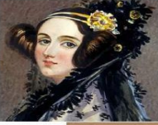
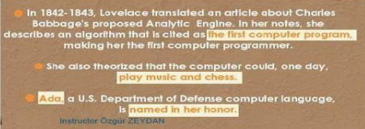
First Computer Programmer
Ada Lovelace is the first person to develop an algorithm for a machine

Slide 20
Algorithm
An algorithm is a list of instructions, procedures, or formulas used to solve a problem.
An algorithm is a step-by-step procedure to solve a problem.
The process of solving a problem becomes simpler and easier with the help of algorithm.
It is better to write algorithm before writing the actual computer program.

Slide 21
Pseudo code
It’s simply an implementation of an algorithm in the form of annotations and informative text written in plain English.
It has no syntax like any of the programming language and thus can’t be compiled or executed.
Also works as a rough documentation, so the program of one developer can be understood easily when a pseudo code is written out.
The main goal of a pseudo code is to explain what exactly each line of a program should do.

Slide 22
Flowchart
Flowchart is a graphical representation of an algorithm.
It is a way of visually presenting the flow of data, operations performed on data and sequence of these operations.
Flowchart use simple geometric symbols and arrows to define relationships.

Slide 23
Example
Pseudo code
Begin
Input A and B
Calculate A+B
Print result of Sum
End
Algorithm
Step 1 : Start.
Step 2 : Read A,B.
Step 3 : Sum = A + B.
Step 4 : Print Sum.
Step 5 : Stop.

Slide 24
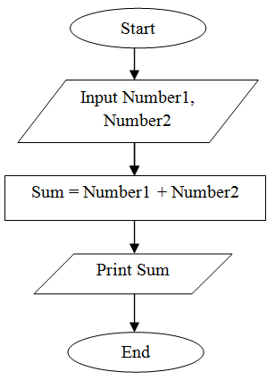
Example
Flowchart

Slide 25
Source Code
The source code consists of the programming statements that are created by a programmer with a text editor or a visual programming tool and then saved in a file.
It is written in a high-level language like C, C++, Java, Python, etc., or assembly language.
Source code is not directly understandable by machine.
Language translators like compiler, assembler, interpreter are used to translate source code to object code.

